Slide 1


Slide 2


Scott Mathis
Olariche Obi
Myles MacDonald
DISK – O – TECH
Patrick Manning

Slide 3


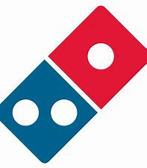







Top Ten App Recommendations
1. PewDiePie Tuber Simulator [Game]
2. Geometry Dash Lite [Game]
Domino’s Pizza
[Food and Drink]
4. Egg, Inc. [Game]
5. Fernanfloo [Game]
6. The Guardian
[News]
7. ASOS [Shopping]
8. Cytus [Game]
9. WhatsApp [Social Networking & Communication]
10. Instagram [Social Networking & Photo /Video]

Slide 4
Calculating App Trader’s Expected Profit
Apps earn $5,000 per month per store from in-app purchasing and advertising
App Trader’s revenue is 50% of that ($2,500 per month per store)
App Trader spends $1,000 per month on marketing costs (even when the app is in both stores)
Therefore, Net Revenue = (Lifespan in months) * $2,500 per store
App Trader purchases apps for 10,000 * the price of the app
Net Profit =
Net Revenue – (Lifespan in months * $1,000) – App Purchase Price

Slide 5
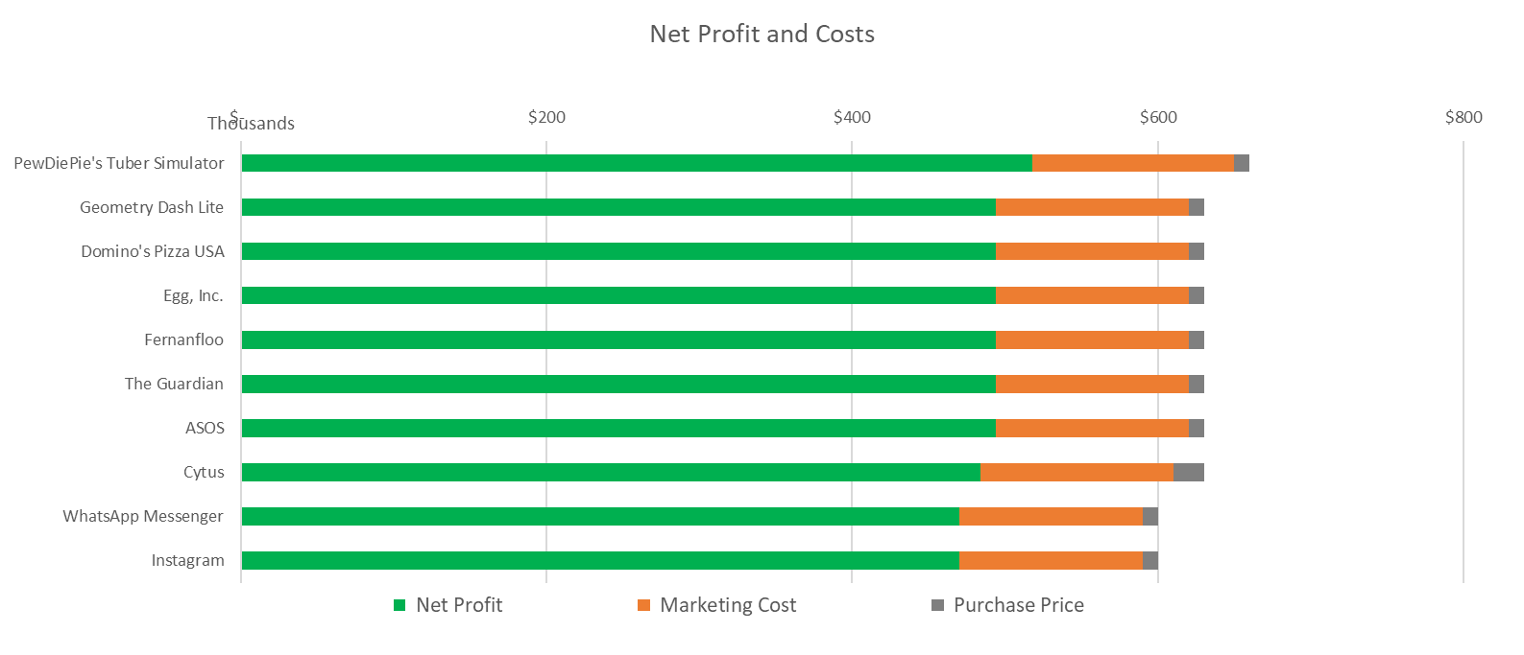
Net Profit and Costs: Top 10 Apps

Slide 6
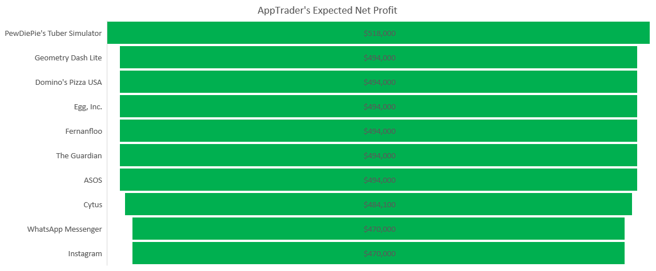
Expected Net Profit: Top 10 Apps

Slide 7
App Recommendations by Star Ratings
All of the Top 10 Apps had an average rating of at least 4.4, with max average rating of 4.9
The apps within the App Store were rated higher on average than those apps in the Google Play Store.
App Store apps had six apps which had perfect five (5) star ratings, whereas Google Play Store apps had none.
Business of Apps “As of Q2 2020, over three times more apps were downloaded through the Google Play Store than through the iOS App Store – 28.7 billion to 9.1 billion”

Slide 8
App Lifespan / Longevity
Calculation for app lifespan: For every half point that an app gains in rating, its projected lifespan increases by one year.
Therefore an app like PewDiePie’s Tuber Simulator who has a 5 star rating in the App Store and a 4.8 star rating in the Google Play Store had a calculated lifespan of roughly 11 years.
((((5 star rating / 5 stars) x 5 ) x 2 + 1) + (((4.8 star rating / 5 stars) x 5) x 2 + 1)) / 2 apps = 10.8
Half
point
+1 accounts for a 0 rating having one year
Half
point
+1 accounts for a 0 rating having one year
Each year has 2 halves
Each year has 2 halves

Slide 9
App Recommendations by Lifespans
Note that the although some apps have a high average rating, their lifespan is lower due to a greater difference in rating between the App Store and the Play Store. Geometry Dash and Dominos have the same lifespan but different average ratings.

Slide 10
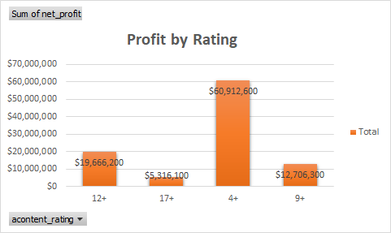
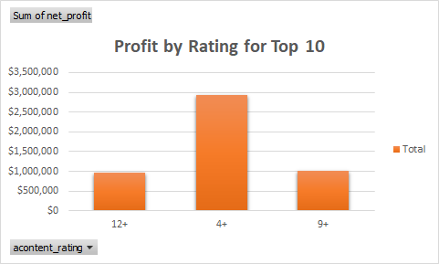
App Recommendations by Content Rating
Content Rating
Content Rating

Slide 11
App Content Rating by Percentage

Slide 12
App Recommendations by Genre
Analysis of genres reveals that games dominate the field, both in terms of review count and net profit.
5 of our top 10 recommended apps are games.
2 of our top 10 recommended apps based on net profit are not in top 10 by review count (News and Shopping).

